Slide 1


Slide 2
LAPTOP OR DESKTOP COMPUTER – Please view in full-screen animation
SLIDE SHOW mode for slide transitions and for full graphic impact.
Select SLIDE SHOW at top of screen and then select the FROM BEGINNING button.
FOR MOBILE DEVICE – While there are no animations to miss on mobile in this deck, you will miss transitions, as well as the full graphic impact of full-screen viewing. For the best experience, please view on laptop or desktop computer in full-screen animation mode.

Slide 3



Slide 4


The Problem
Jewish philanthropy is currently largely dependent on a small sect within the wider community context. The community places its needs in the hands of a very few.
With an ageing population demographic, increasing rate of assimilation and general rise in cost of living, the requirements placed on philanthropic giving will be exacerbated. (2016 Census Analysis; Gen 17)
The importance of charitable giving decreases in younger givers. (Gen 17)

Slide 5


Our Mission & Vision
Realizing the potential of future game changers by providing them with the necessary time, treasure and talent.
Create a continuously growing base of sustainable philanthropy that enables a vibrant Jewish community in Australia for future generations.

Slide 6
LaunchPadX
An Australian Jewish Funder (“AJF”) initiative that connects Australian “for-profit” innovation, philanthropy with a Jewish lens and the Australian Jewish community. The initiative is based
on the Mamilla program1 run in 2016.
“For Profit” Innovation
Support entrepreneurs who have the potential to transform the Australian landscape, embolden the Australian start-up culture and generate economic growth
Provide as platform to
enable visionaries who
will create the world
of the future
Connect & Strengthen Jewish Community
Stimulate Jewish Philanthropy
Provide infrastructure that
enables giving
Inspire by connecting game changers and philanthropic leaders
Ignite philanthropic energy
1
2
The Mamilla Program … . The program was led by Tracie Olcha (CEO, AJF), Amanda Miller and Ronen Hein

Slide 7

The LaunchPadX Formula
A
Six month program
Paves the way for the next generation of passionate innovators in the Australian
Jewish community
Integrate tools to create successful businesses
with philanthropy and social impact
B
Leveraging our AJF members
& leaders across the Australian
Jewish community
Inspire, coach and fast-track budding Jewish entrepreneurs
Mentoring game-changers, ensuring that they
turn their big ideas and start-ups into leading businesses
C
Matching budding game changers with successful business leaders, investors and community leaders
Coaches have seen extraordinary success across industries and disciplines
Coaches have joined to work alongside game changers to help develop a new generation of entrepreneurs and philanthropists in the Australian Jewish Community

Slide 8


LaunchPadX–Philanthropic Model
LaunchPadX
Funded by AJF members
Co-working space/innovation hub
Program manager
Curriculum, full incubation program
roll-out
Access to best of breed coaches, industry experts and innovation
domain experts
Volunteers
Coaches
Industry experts (Venture
Capitalists, Entrepreneurs)
Domain mentors (Designers,
Marketers, Engineers)
Philanthropists
Game Changers
AJF Philanthropic Fund
Supports funding of key challenges
in the Australian Jewish Community Governed by a sub-committee of
the AJF Board

Slide 9





The People
Entrepreneurs & visionaries with ideas that will transform the world
Is All About the People
Game Changers
(Entrepreneurs)
Volunteers
Coaches
Industry experts (Venture
Capitalists, Entrepreneurs)
Domain mentors (Designers,
Marketers, Engineers)
Philanthropists
Coaches
Industry Experts
Respected
and successful entrepreneurs, investors and community leaders
People who
have “been
there, done that”

Slide 10


Managed under the AJF umbrella
LaunchPad
Idea formed during LaunchPad 2019 retreat when reflecting on problems in
the Jewish Community
Philanthropy
AJF has diverse philanthropic thought leadership
at the table
Experience
Proof of concept already done... Mamilla 2016
Shared values
We share
values around innovation, collaboration
and leadership
Network
AJF has an established network of leaders, strategic philanthropists
and activists

Slide 11

Appendix 1: LaunchPadX Program
1
2
2
Setting up a proposition
Building a MVP
Getting investment
Philanthropy
Jewish communal needs
Financial modelling
Legal considerations
Venture capital
Developing pitches
Thriller of LaunchPadX
Building relationship –
Game-changers/coach
Agile methodologies
Human Centered Design
Growth hacking
Go-to-market
Customer-acquired
Israel
study tour
Biz tools (IT/Apps)
Month 1
Month 2
Month 3
Month 4
Assumptions
- COVID-19 restrictions lifted allowing Israel study tour to take place

Slide 12
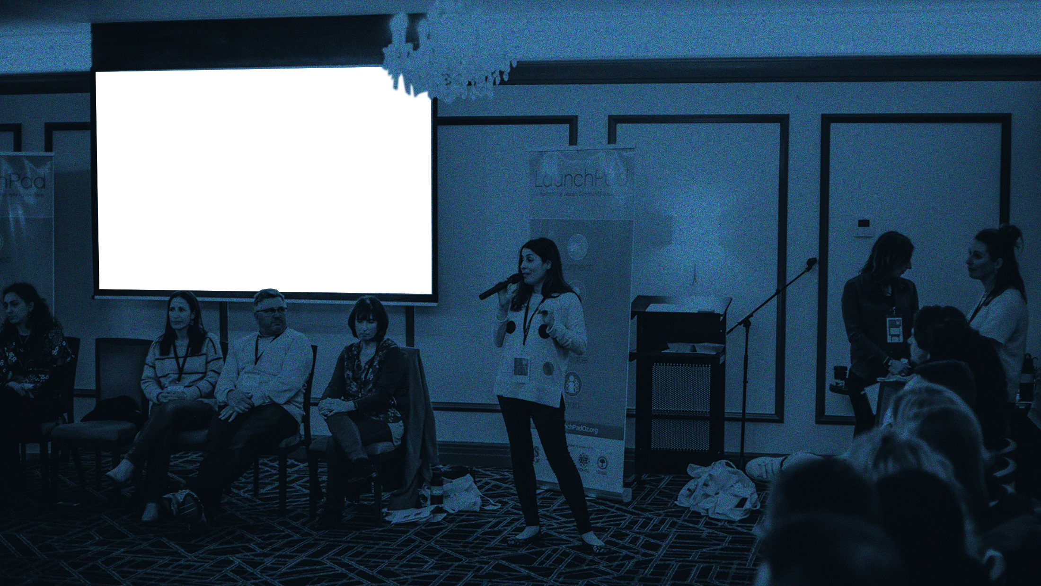
Questions

Slide 13



212.529.0075
dan@newmarkdigital.com
www.NewmarkDigital.com

