Slide 1
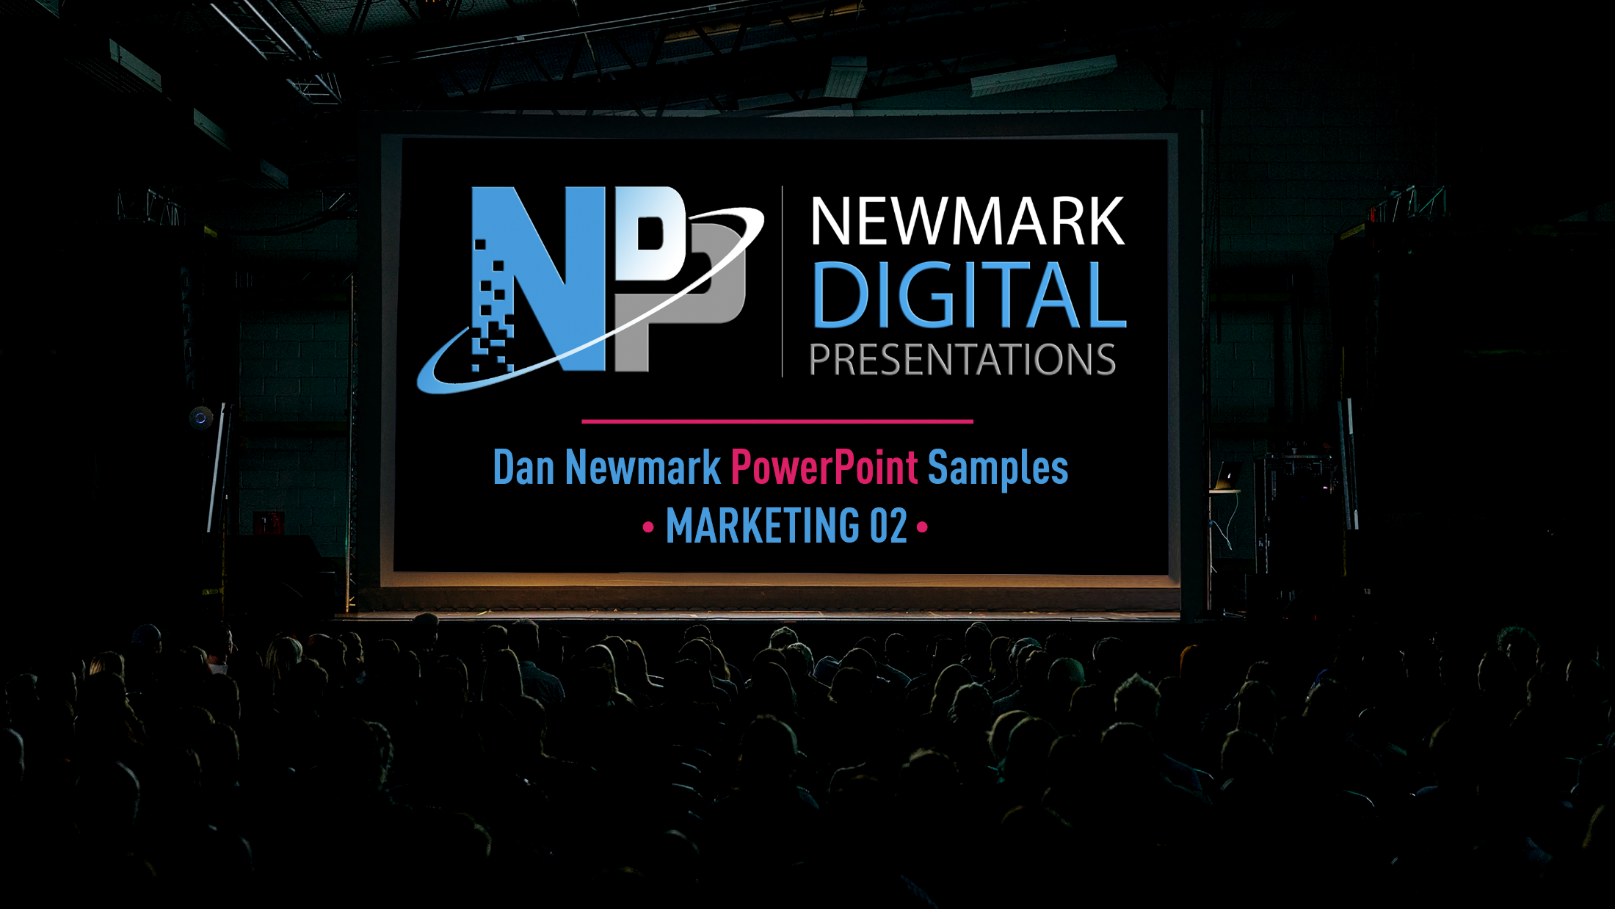

Slide 2
FOR LAPTOP OR DESKTOP COMPUTER – Please view presentation in full-screen animation SLIDE SHOW mode or you are not really seeing it, as there are animated layers that move and fade and that not make visual sense when viewed outside of animation mode.
Select SLIDE SHOW at top of screen and then select the FROM BEGINNING button.
FOR MOBILE DEVICE – Because animation does not work on this platform, graphics on some slides will look jumbled. This is because overlapping layers
of animation cannot be deployed. To see presentation as intended, please view on laptop or desktop computer in full-screen animation mode.

Slide 3

Teradata Marketing
presents
Titan Fuel’s Story

Slide 4

Roger, a member of Marie’s network, meets Marie in a coffee
shop to ask how she recovered from a recent revenue slide.
Marie, the Chief Marketing Officer for Titan energy products, is happy to help. She begins telling her story, starting with a Time Graph report from Teradata Omni-Channel Marketing Solutions. The chart showed that her sales were declining, and she needed
to turn around fast.
Notes:
Long copy version (includes information that might be useful for talk track):
Roger, a member of Marie’s network, meets Marie in a coffee shop to ask how she recovered from a recent revenue slide. Marie, the Chief Marketing Officer for Titan energy products, is happy to help. She begins telling her story, starting with a Time Graph report from Teradata Omni-Channel Marketing Solutions. The chart showed that her sales were declining, and she needed to turn them around fast.

Slide 5

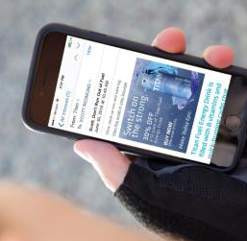
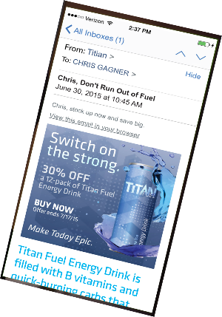
Athletic Consumer
The next day…
Scott receives an email featuring the same offer.
Dynamic email content—
presented on opening--coupled with individualized offers increases conversions.
For demonstration purposes only

Slide 6
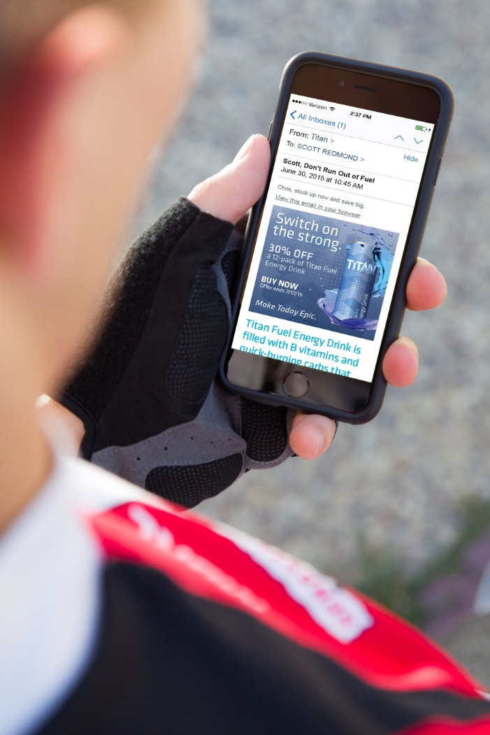
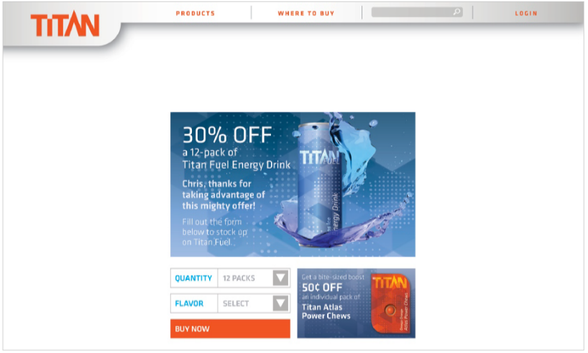
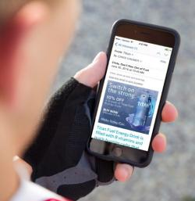
Athletic Consumer
Teradata automatically presents the offers most likely to engage each customer.
Scott goes to his personalized landing page and makes
a purchase.
Notes:
Talk Track (TDI disregard): ads/offers in email and on landing page are generated by RTIM
Long copy version (includes information that might be useful for talk track):
Scott clicks through to his personalized landing page, selects his desired flavor and quantity, and clicks Buy Now.

Slide 7



Inside Titan
Angela is responsible for encouraging existing customers to buy more Titan energy products.
Notes:
Long copy version (includes information that might be useful for talk track):
Angela, the Relationship Marketer for Titan, is responsible for encouraging existing customers to buy more Titan energy products.

Slide 8






Inside Titan
Angela is responsible for encouraging existing customers to buy more Titan energy products.
Mark is responsible for placing ads on the Titan website and managing Titan’s email marketing.
Notes:
Long copy version (includes information that might be useful for talk track):
Mark, the Digital Marketer, is responsible for placing ads on the Titan website as well as managing Titan’s email marketing.

Slide 9

Inside Titan
They use analytics to put together a campaign for Titan Fuel energy drink.
Notes:
Long copy version (includes information that might be useful for talk track):
Together, they use analytics to put together a campaign offering 30% off a 12-pack of Titan Fuel energy drink.

Slide 10
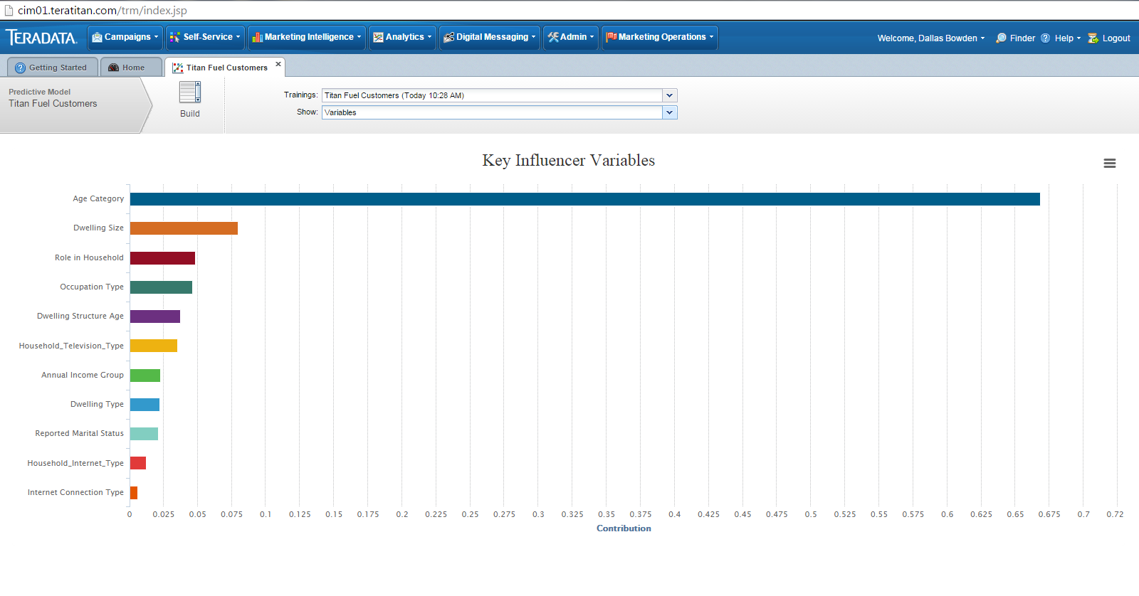
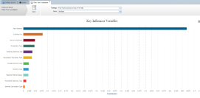
Inside Titan
Predictive Analytics shows us that age is our key influencer in Titan Fuel purchases.

Slide 11
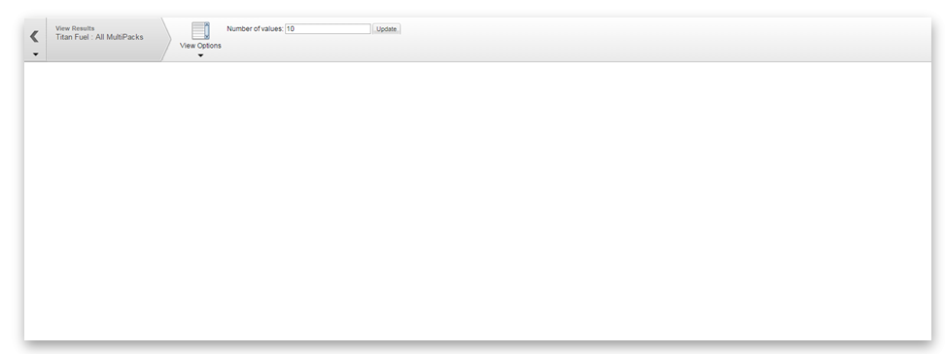
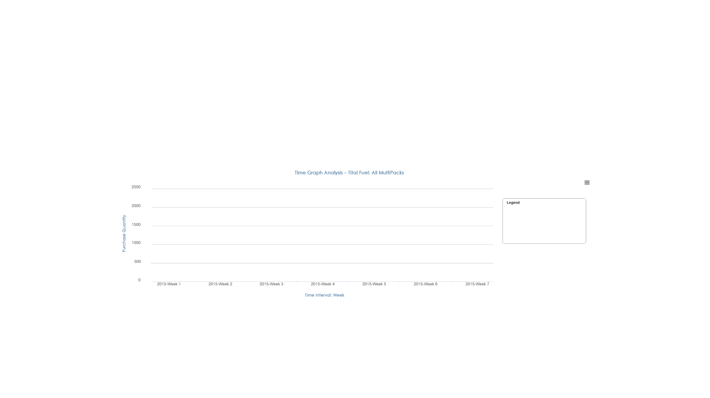
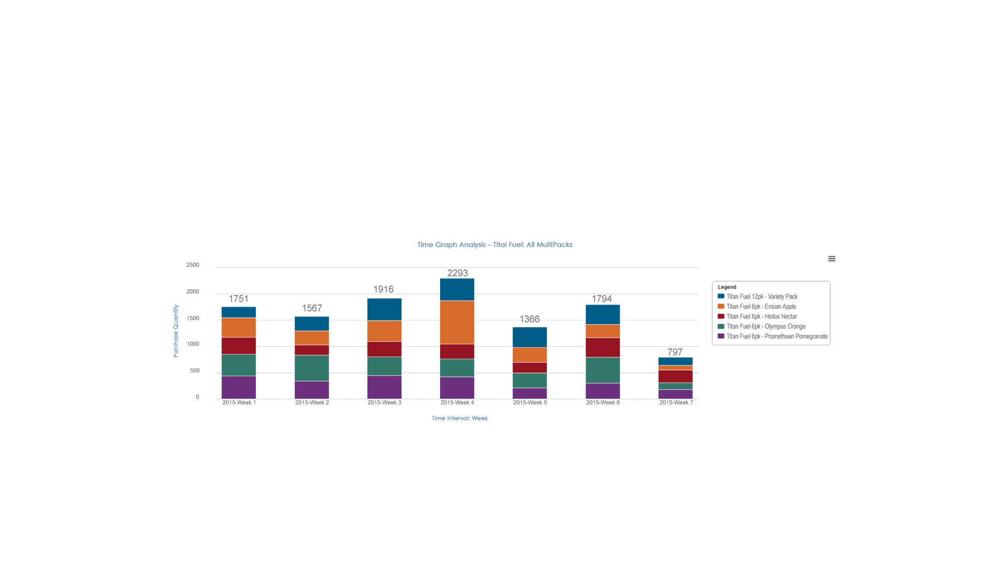
Inside Titan
Teradata Analytics helped Titan be more agile, adjusting quickly to market opportunities in order to achieve revenue goals.
Time Graph Analysis – Titan Fuel: All MultiPacks
2500
2293
2000
1751
1916
1794
1500
1567
1366
Purchase Quantity
1000
797
500
0
2015-Week 1
2015-Week 2
2015-Week 3
2015-Week 4
2015-Week 5
2015-Week 6
2015-Week 7
Time Interval: Week
Time Graph Analysis shows Titan Fuel revenue has been trending
down in recent weeks.

Slide 12
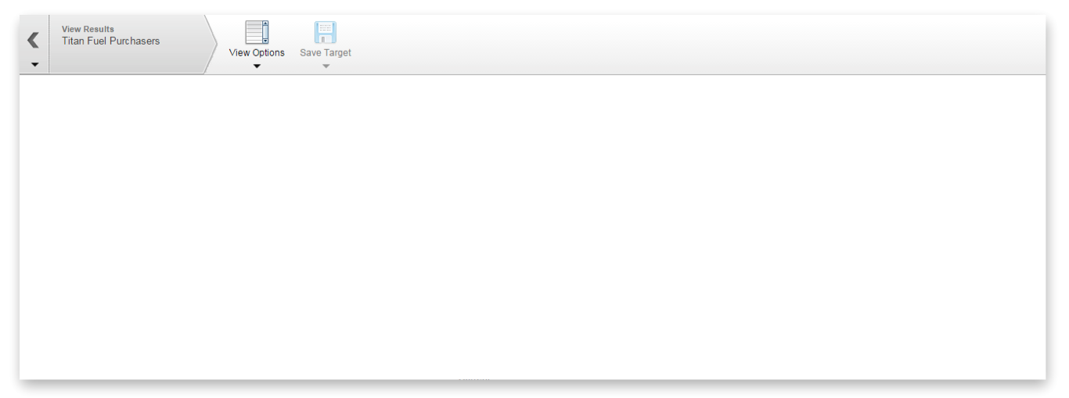
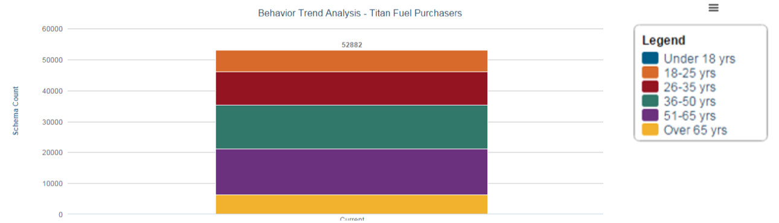
Inside Titan
Marketing analytics are built right in, giving your marketing team the
highly actionable insights they need for day-to-day planning, tracking,
and measuring.
Behavior Trend Analysis – Titan Fuel Purchasers
60000
{
5282
18-25 yrs
26-35 yrs
50000
Under18 yrs
18-25 yrs
26-35 yrs
36-50 yrs
51-65 yrs
Over 65 yrs
40000
Schema Count
30000
20000
10000
0
Current
Behavior Trend Analysis shows an opportunity to expand sales among
18 to 35 year olds.
Notes:
Talk track note (TDI disregard): Discuss how our solutions can help with targeting existing customers to buy more/new product, as well as help marketers target new customers with similar attributes to the existing customer base.

Slide 13

Teradata Interactive Services
From creative strategy to pre- and post-sales nurturing, analytics, and optimization, our integrated solutions are built on industry best practices. This foundation allows us to develop cross-channel programs that drive awareness, adoption, and loyalty.
Acquisition
Strategy
Analysis
Segmentation
Successful
Digital
Marketing
Automation
Design
Deliverability

Slide 14



Teradata Interactive Services
Data-Driven Campaign Support
From creative strategy to pre- and post-sales nurturing, analytics, and optimization, our integrated solutions are built on industry best practices. This foundation allows us to develop cross-channel programs that drive awareness, adoption, and loyalty.
Through experiences and communications that strengthen relationships between brands and their consumers, we help turn insights into meaningful interactions – with results that are as measureable
as they are memorable.
Acquisition
Strategy
Analysis
Segmentation
Successful
Digital
Marketing
Client
Input
Strategic
Development
Creative
Development
Automation
Design
Deliverability
Functional
Discovery
UI
Development
Technical
Development

Slide 15
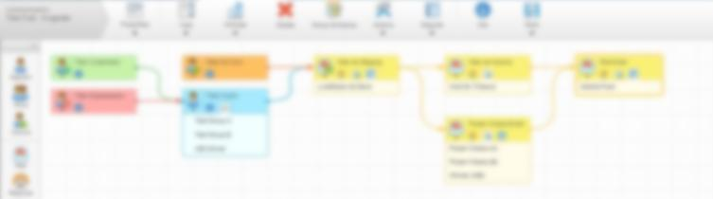
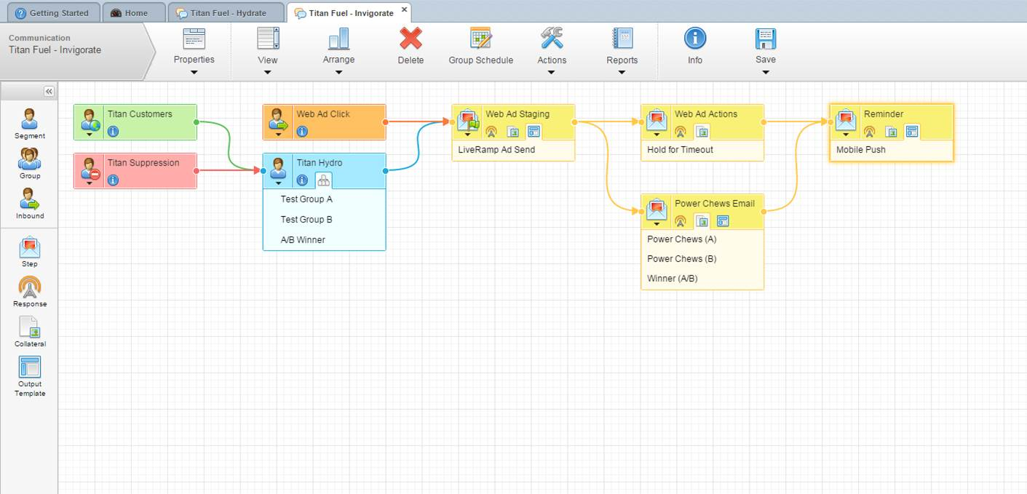
Inside Titan
Teradata helped Titan engage their customer across multiple channels and devices – ensuring their message was relevant and timely.
This is a more complex campaign that features A/B testing, LiveRamp integration, and mobile push notifications all in one communication flow.

Slide 16

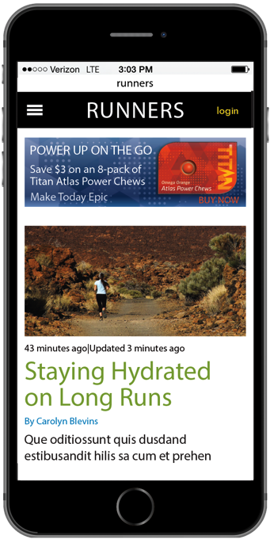

Athletic Consumer
Later, Greg visits runners.com and sees our Atlas Power Chews offer.
He installs the Titan app to learn more, but forgets to click the ad.
Notes:
Long copy version (includes information that might be useful for talk track):
Later at home, Greg visits runners.com (a site he frequents) and sees our ad for $3 off an 8-pack of Atlas Power Chews.
Greg installs the Titan app to learn more. He then gets distracted by his dog and forgets to click the ad to get his coupon.

Slide 17


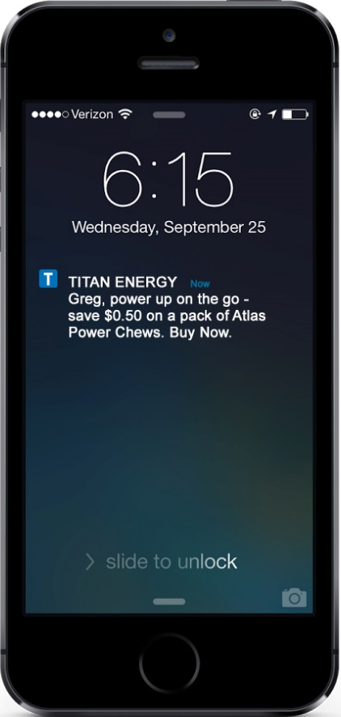

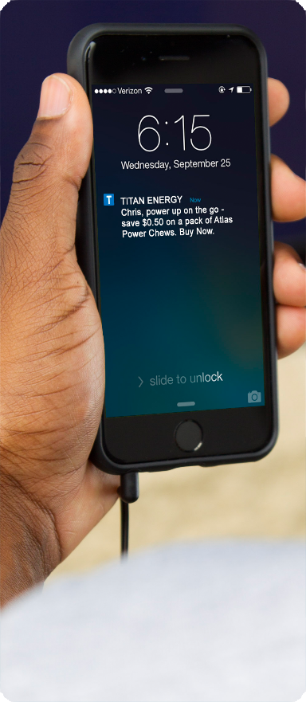
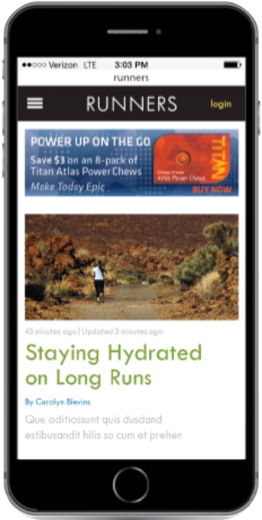
Athletic Consumer
Greg gets a push notification on his mobile phone
with a 50¢ off coupon for Atlas Power Chews.
Greg installs the Titan app to learn more. He then gets distracted by
a dog and forgets to click the
ad to get his coupon
Notes:
Long copy version (includes information that might be useful for talk track):
Next time Greg is out running, he stops at the same convenience store. Just outside, he gets a very timely push notification on his mobile phone that offers him a coupon for 50¢ off an individual pack of Atlas Power Chews.

Slide 18

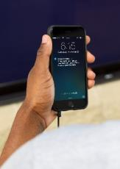
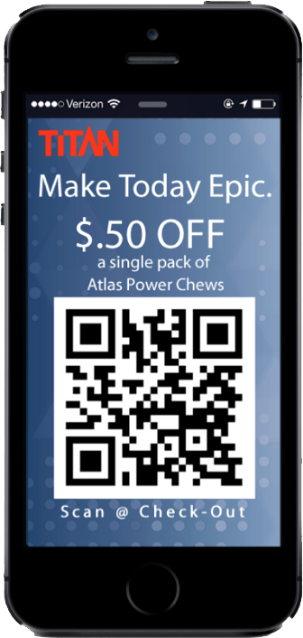
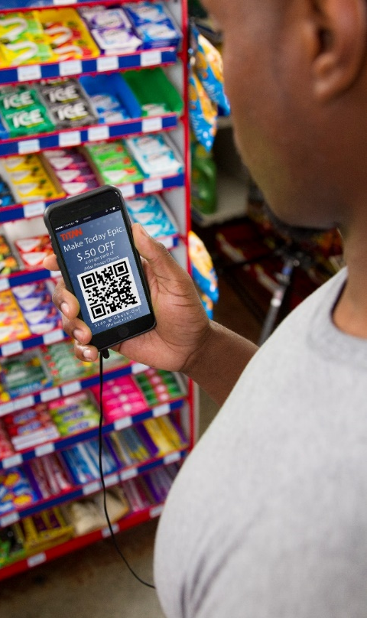
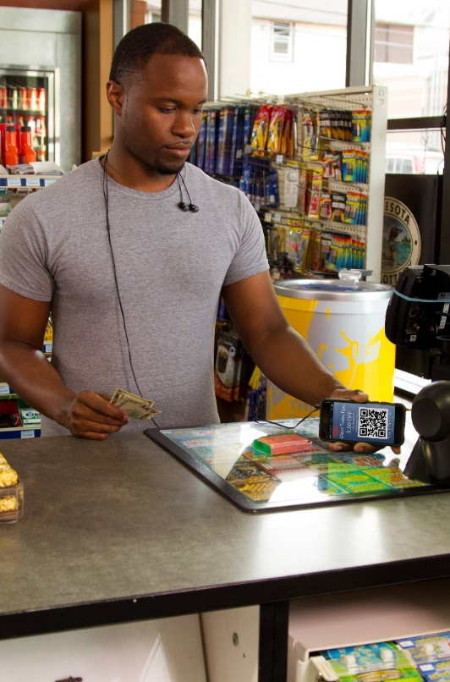
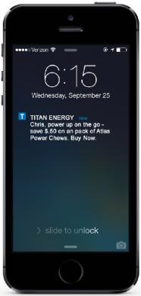
Athletic Consumer
Just outside, he gets a very timely push notification on his mobile phone that offers him a coupon
for 50 cents off
an individual pack of Atlas Power Chews.
Greg clicks the notification and uses the coupon in-store.
Next time Greg is out running, he stops at the same convenience store.
Notes:
Long copy version (includes information that might be useful for talk track):
Greg clicks the notification to get a coupon, then uses that coupon in-store to buy a pack of Power Chews.

Slide 19

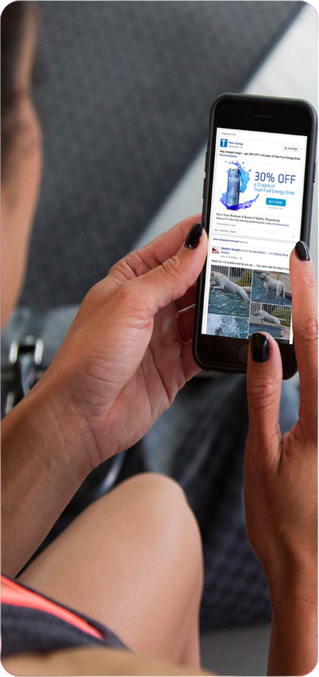
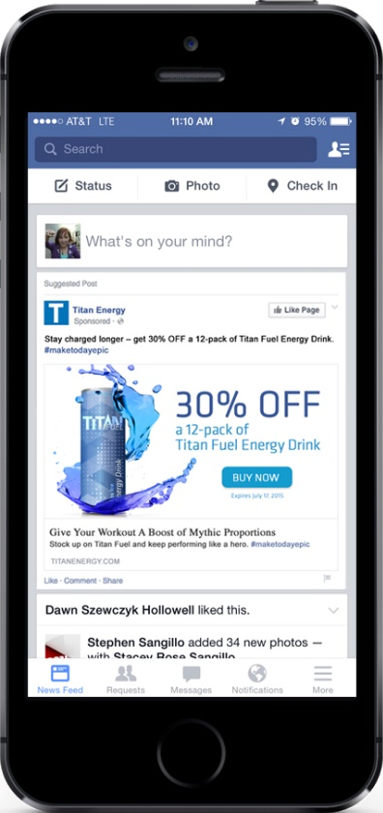
Athletic Consumer
Rebecca sees Titan’s sponsored ad on Facebook and shares
it with her friends.
Monitor conversations about your
brand so you can respond quickly to your audience.
Notes:
Long copy version (includes information that might be useful for talk track):
Rebecca, a triathlete, is viewing her newsfeed and sees Titan’s sponsored ad for 30% off a 12-pack of Titan Fuel energy drink. She shares the ad with her friends.

Slide 20


Athletic Consumer
We follow up the next day with an email reinforcing
the 30% offer.
Reach customers through channels and devices where they are already spending their time, rewarding their advocacy.
Notes:
Long copy version (includes information that might be useful for talk track):
We know that Rebecca shared the Facebook ad, and we follow up the next day with an email reinforcing the 30% offer.

Slide 21
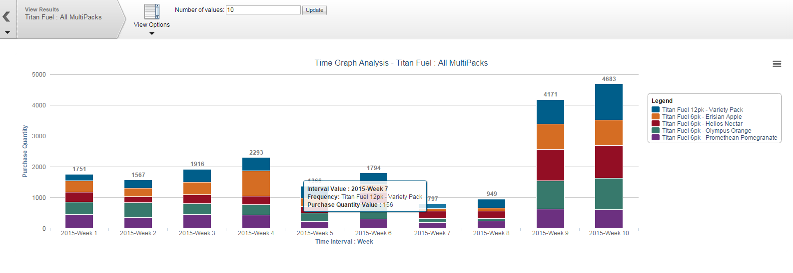
Inside Titan
Revenue has increased significantly as a result of the loyalty and acquisition campaigns.

Slide 22

Inside Titan
Teradata Interactive Services can power your marketing
with individualized consumer insights and strategic services. Offering multi-channel expertise and an emphasis on data-driven marketing and optimization, we make one-to-one customer connections easy.

Slide 23
Thank You
Notes:
Global comment:
PPT should automatically keep playing.

Slide 24



212.529.0075
dan@newmarkdigital.com
www.NewmarkDigital.com

